Slide 1
Software Evolution and Maintenance
A Practitioner’s Approach
Chapter 5
Legacy Information Systems
Notes:
Handouts
------------------------------------------------------------------
------------------------------------------------------------------
-------------------------------------------------------------------
--------------------------------------------------------------------

Slide 2
Outline of the Chapter
5.1 General Idea
5.2 Wrapping
5.2.1 Types of Wrapping
5.2.2 Levels of Encapsulation
5.2.3 Constructing a Wrapper
5.2.4 Adapting a Program for Wrapper
5.3 Migration
5.4 Migration Planning
5.5 Migration Methods
5.5.1 Cold Turkey
5.5.2 Database First
5.5.3 Database Last
5.5.4 Composite Database
5.5.5 Chicken Little
5.5.6 Butterfly
5.5.7 Iterative
Notes:
Handouts

Slide 3
5.1 General Idea
In Oxford English Dictionary (OED) the word “legacy” is defined as
  A sum of money, or a specified article, given to another by will; anything handed down by an ancestor or predecessor.
Brodie and Stonebraker used the following definition to define legacy systems:
  any information system that significantly resists modification and evolution to meet new and constantly changing business requirements.
Bennett used the following definition to define legacy systems:
  Legacy software systems are large software systems that we don’t know how to cope with but that are vital to our organization.
Supporting the definitions are a set of acceptable features of a legacy system:
  • large with millions of lines of code.
  • geriatric, often more than 10 years old.
  • written in obsolete programming languages.
  • lack of consistent documentation.
  • poor management of data, often based on flat-file structures.
  • degraded structure following years of modifications.
  • very difficult, if not impossible, to expand.
  • runs on old processor.
Notes:
Handouts

Slide 4
5. 1 General Idea
There are several categories of solutions for legacy information system (LIS).
These solutions generally fall into six categories as follows:
  Freeze.
  Outsource.
  Carry on maintenance.
  Discard and redevelop.
  Wrap.
  Migrate.
Notes:
Handouts

Slide 5
5.2 Wrapping
In 1988, first introduced the concept of a “wrapper” at IBM.
Wrapping means encapsulating the legacy component with a new software layer that provides a new interface and hides the complexity of the old component.
The encapsulation layer can communicate with the legacy component through sockets, remote procedure calls (RPCs), or predefined application program interfaces (API).
The wrapped component is viewed similar to a remote server; it provides some service required by a client that does not know the implementation details of the server.
Notes:
Handouts

Slide 6
5.2.1 Types of Wrapping
  Database wrappers.
  System service wrappers.
  Application wrappers.
  Function wrappers.
1- Database wrappers:
Database wrappers can be further classified into forward wrappers (f-wrappers) and backward wrappers (b-wrappers)
The forward wrappers-approach, depicted in Figure 5.1, shows the process of adding a new component to a legacy system.
Therefore, by means of translation service involving both legacy data and queries, the wrapper integrates the new component with the legacy system.
The backward wrappers-approach has been depicted in Figure 5.2
In this approach, data are migrated first then new components are developed that use the new database; the legacy components access the new data via wrappers.
Notes:
Handouts

Slide 7
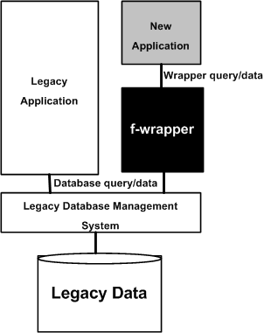
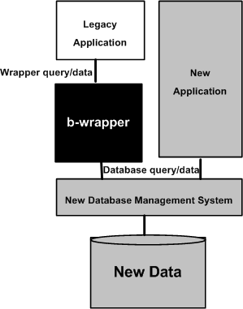
5.2.1 Types of Wrapping
Figure 5.1Forward wrapper © ACM, 2006
Figure 5.2 Backward wrapper © ACM, 2006
Notes:
Handouts

Slide 8
5.2.1 Types of Wrapping
2- System service wrappers:
This kind of wrappers support customized access to commonly used system services, namely, routing, sorting, and printing.
A client program may access those services without knowing their interfaces.
3- Application wrappers:
This kind of wrappers encapsulate online transactions or batch processes.
These wrappers enable new clients to include legacy components as objects and invoke those objects to produce reports or update files.
4- Function wrappers:
This kind of wrappers provide an interface to call functions in a wrapped entity.
In this mechanism, only certain parts of a program – and not the full program – are invoked from the client applications.
Therefore, limited access is provided by function wrappers.
Notes:
Handouts

Slide 9
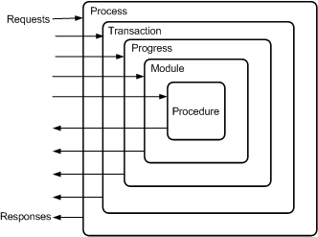
5.2.2 Levels of Encapsulation
There are five levels of granularity: procedures are at the lowest level and processes are at the highest level.
Figure 5.3 Levels of encapsulation ©IEEE, 1996
Notes:
Handouts

Slide 10
5.2.2 Levels of Encapsulation
1- Process level:
A job is started on the server which accepts input data, accesses databases, and produces output data.
Upon the completion of the job, the wrapper takes over the output files to be forwarded to the client.
2- Transaction level:
On the server, a virtual terminal is created that sends the terminal input map and receives the terminal output map.
The wrapper is a program which simulates the user terminal.
Notes:
Handouts

Slide 11
5.2.2 Levels of Encapsulation
3- Program level:
Via APIs, batch programs are called in a wrapper.
The wrapper substitutes program inputs with data inputs coming in from the client application.
In addition, outputs from the wrapped program are captured, reformatted, and sent to the client.
4- Module level:
Legacy modules are executed using their standard interfaces.
A significant deviation from the usual calls is that parameters are passed by value – and not by references.
Therefore, first, the wrapper buffers the received values in its own address space.
Next, the buffered values are passed on to the invoked module.
Finally, the output values received from the invoked module are passed on to the client.
Notes:
Handouts

Slide 12
5.2.2 Levels of Encapsulation
5- Procedure level:
A procedure internal to the system is invoked as if the procedure was compiled separately.
As a result, this special treatment of an internal procedure requires:
  (i) constructing a parameter interface; and
  (ii) if needed, initializing global variables before calling the procedure.
Notes:
Handouts

Slide 13
5.2.3 Constructing a Wrapper
A legacy system is wrapped in three steps as follows:
  A wrapper is constructed.
  The target program is adapted.
  The interactions between the target program and the wrapper are verified.
A wrapper, is a program which receives input messages from the client program, transforms the inputs into an internal representation, and invokes the target system with the newly formatted messages.
The wrapper intercepts the outputs produced by the target system, transforms them into a format understood by the client, and transfers them to the client.
Notes:
Handouts

Slide 14
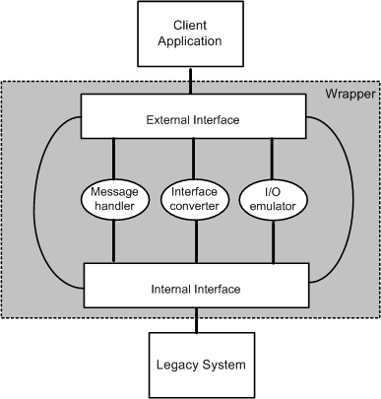
5.2.3 Constructing a Wrapper
Conceptually, a wrapper comprises two interfaces and three event driven modules as shown in Figure 5.4.
The two interfaces are an internal interface and an external interface, and the three modules are message handler, interface converter, and I/O-emulator.
Figure 5.4 Modules of a wrapping framework
Notes:
Handouts

Slide 15
5.2.3 Constructing a Wrapper
External interface:
The interface of the wrapper that is accessed by the clients is called the external interface.
The wrapper and its client generally communicate by passing messages.
Messages normally comprise a header and a body.
The header of a message contains control information:
  (i) identity of the sender.
  (ii) a time stamp.
  (iii) the transaction code.
  (iv) target program type.
  (v) the identity of the transaction, program, procedure, or module to be invoked.
The message body contains the input arguments. Similarly, the message body contains the output values in an output message.
The values contained in a message are normally ASCII strings separated by a delimiter, say, a back slash ( “\” ).
Notes:
Handouts

Slide 16
5.2.3 Constructing a Wrapper
Internal interface:
A wrapper’s internal interface is the interface visible to the server.
The internal interface is dependent upon the language and type of the wrapped entity.
For example, if the wrapped entity is a job, the internal interface of the wrapper is a job control procedure, and the job control procedure is interpreted to execute the job.
On the other hand, if the encapsulated entity is a program, procedure, transaction, or a module, the internal interface is alist of parameters in the language of the encapsulated software.
Therefore, the internal interface is extracted from the source code of the encapsulated software.
The parameters of the internal interface are specified in terms of the target language, thereby necessitating a translation from the input ASCII strings to the target types.
Notes:
Handouts

Slide 17
5.2.3 Constructing a Wrapper
Message handler:
The message handler buffers input and output messages, because requests from the client may occasionally arrive at a faster rate than they can be consumed.
Similarly, outputs from the wrapped program may be produced at a faster rate than they can be sent to the client.
Interface converter:
This entity converts the internal interface into the external interface and vice-versa.
I/O-emulator:
I/O-emulator intercepts the inputs to and outputs from the wrapped entity.
Upon intercepting an input, the emulator fills the input buffer with the values of the parameters of the external interface.
On the other hand, when it intercepts an output value, the emulator copies the contents of the output buffer into the parameter space of the external interface.
Notes:
Handouts

Slide 18
5.2.4 Adapting a Program for Wrapper
A wrapped program is modified to some extent, and it is expected that the modified programs continue to operate in the normal mode.
Programs are adapted with tools, rather than manually.
There are four types of tools:
  Transaction wrapper.
  Program wrapper.
  Module wrapper.
  Procedure wrapper.
Notes:
Handouts

Slide 19
5.2.5 Screen Scraping
Screen scraping is a common form of wrapping in which modern, say, graphical, interfaces replace text-based interfaces.
The new interface can be a GUI (graphical user interface) or even a web-based HTML (hypertext markup language) client.
Screen scraping simply provides a straightforward way to continue to use a legacy system via a graphical user interface.
Screen scraping is a short term solution to a larger problem.
Many serious issues are not addressed by simply mounting a GUI on a legacy system. For example, screen scraping:
  (i) does not evolve to support new functions.
  (ii) incurs high maintenance cost.
  (iii) ignores the problem of overloading.
  Overloading is simply defined as the ability of one function to perform different tasks.
Notes:
Handouts

Slide 20
5.3 Migration
Migration of LIS is the best alternative, when wrapping is unsuitable and redevelopment is not acceptable due to substantial risk.
It offers better system understanding, easier maintenance, reduced cost, and more flexibility to meet future business requirements.
Migration involves changes, often including restructuring the system, enhancing the functionality, or modifying the attributes.
It retains the basic functionality of the existing system.
Notes:
Handouts

Slide 21
5.3 Migration
LIS migration involves creation of a modern database from the legacy database and adaptation of the application program components accordingly.
A database has two main components: schema of the database and data stored in the database.
Therefore, in general, migration comprises three main steps:
(i) conversion of the existing schema to a target schema: means translating the legacy database schema into an equivalent database structure expressed in the new technology.
(ii) conversion of data: means movement of the data instances from the legacy database to the target database. It requires three steps:
1- extract, transform, and load (ETL). extract data from the legacy store.
2- transform the extracted data so that their structures match the format. In addition, perform data
cleaning (a.k.a. scrubbing or cleansing) to fix or discard data that do not fit the target database.
3- load the transformed data in the target database.
(iii) conversion of program: means modifying a program to access the migrated database instead of the legacy data.
  The conversion process leaves the functionalities of the program unchanged.
  Program conversion depends upon the rules that are used in transforming the legacy schema into the target schema.
Notes:
Handouts

Slide 22
5.3 Migration
Testing and Functionality:
It is important to ensure that the outputs of the target system are consistent with those of the LIS.
Therefore, new functionality is not to be introduced into the target system in a migration project.
If both the LIS and the target system have the same functionality, it is easier to verify their outputs for compliance.
However, to justify the project expense and the risk, in practice, migration projects often add new functionalities.
Notes:
Handouts

Slide 23
5.3 Migration
Cut over or Roll over:
The event of cutting over to the new system from the old one is required to cause minimal disruption to the business process.
There are three kinds of transition strategies.
Cut-and-Run: The simplest transition strategy is to switch off the legacy system and turn on the new system.
Phased Interoperability: To reduce risks, cut over is gradually performed in incremental steps.
Parallel Operation: The target system and the LIS operate at the same time. Once the new system is considered to be reliable, the LIS is taken off service.
Notes:
Handouts

Slide 24
5.4 Migration Planning
The activity of planning for migration comprises thirteen steps:
Step 1: Perform portfolio analysis.
Step 2: Identify the stakeholders.
Step 3: Understand the requirements.
Step 4: Create a business case.
Step 5: Make a go or no-go decision.
Step 6: Understand the LIS.
Step 7: Understand the target technology.
Step 8: Evaluate the available technologies.
Step 9: Define the target architecture.
Step 10: Define a strategy.
Step 11: Reconcile the strategy with the needs of the stakeholder.
Step 12: Determine the resources required.
Step 13: Evaluate the feasibility of the strategy.
Notes:
Handouts

Slide 25
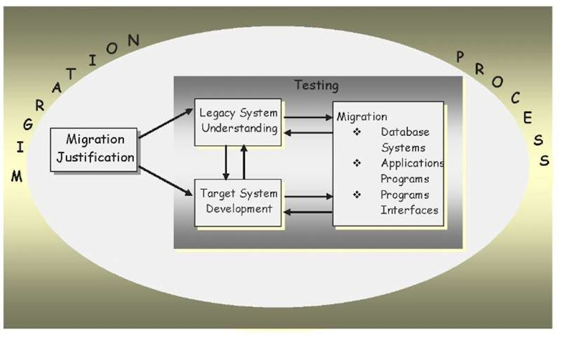
5.5 Migration Methods
No single approach can be applied to all kinds of legacy systems, because they vary in their scale, complexity, and risks of failure while migrating.
The seven approaches are as follows:
  Cold turkey
  Database first
  Database last
  Composite database
  Chicken little
  Butterfly
  Iterative
Notes:
Handouts

Slide 26
5.5.1 Cold Turkey
The Cold turkey strategy is also referred to as the Big Bang approach.
It involves redesigning and recoding the LIS from the very beginning using a new execution platform, modern software architecture, and new tools and databases.
For this approach to be adopted, one must guarantee that the renovated system will include many new features in addition to the functionality provided by the original legacy system.
The risk of failure is increased due to the complexity of migration.
This approach can be adopted, if a legacy system has stable, well-defined functionality and is small in size.
Notes:
Handouts

Slide 27
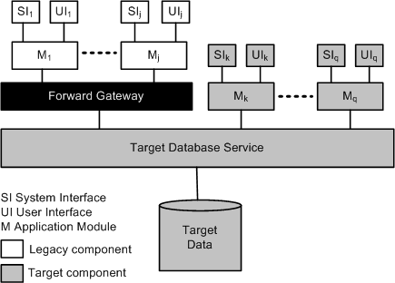
5.5.2 Database First
The Database first approach is also known as forward migration method.
This method first migrates the database, including the data, to a modern DBMS, and then gradually migrates the legacy application programs and interfaces.
The LIS simultaneously operates with the new system via a forward gateway, while interfaces and legacy applications are being reengineered.
The forward gateway translates legacy application calls to target calls.
Figure 5.6 Database first approach ©IEEE, 1999
Notes:
Handouts

Slide 28
5.5.2 Database First
A key benefit of the database-first approach is that upon the completion of migration of the legacy data, one can start receiving productivity benefits by accessing the data.
This approach has three major drawbacks.
  First, the approach is only applicable to a completely decomposable legacy system, where a clean interface to the legacy database exists.
  Second, the new database structure must be defined before migration can begin.
  Third, it is difficult to construct the forward gateway.
An information system is said to be fully decomposable if the user and system interfaces, applications, and databases are considered to be distinct components connected by clearly defined interfaces.
In a semidecomposable information system, only the user and the system interfaces are separate components; the database service and applications are inseparable.
A nondecomposable information system is one where no functional components can be separated
Notes:
Handouts

Slide 29
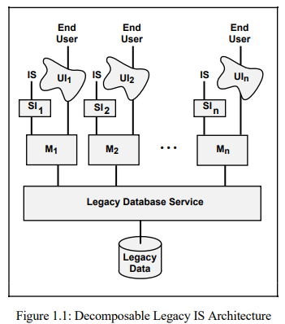
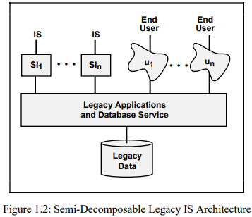
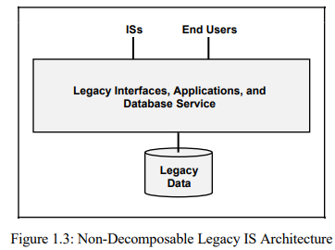
Architectures

Slide 30
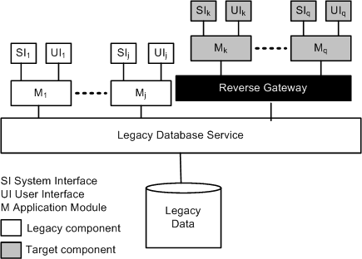
5.5.3 Database Last
It is suitable only for a fully decomposable LIS.
In this approach, legacy applications are incrementally migrated to the target platform, but the legacy database stays on the original platform.
Migration of the database is done last.
Similar to the database-first approach, the information systems is supported by means of a gateway.
Target applications access the LIS database via a reverse gateway.
As illustrated in Figure, the reverse gateway translates calls from the new applications and redirects them to the legacy database.
Figure 5.7 Database last approach ©IEEE, 1999
Notes:
Handouts

Slide 31
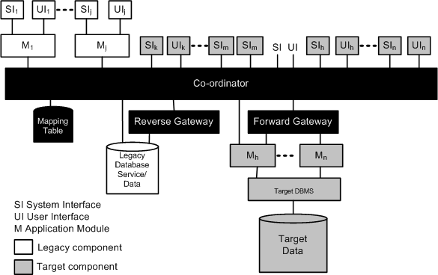
5.5.4 Composite Database
The Composite database approach is applicable to fully decomposable, semi-decomposable, and non-decomposable legacy information systems.
In the composite database approach, the target information system is run in parallel with the legacy system during the migration process.
In the beginning, the target system is a small one, but it grows in size as migration continues.
While migration is continuing, as shown in Figure 5.8, the two systems form a composite information system, employing a combination of forward and reverse gateways.
Upon completion of the migration process, all the functionality of the old system are performed by the new system.
In this approach, data may be duplicated across both the databases: legacy and target.
A transaction co-coordinator is employed to maintain data integrity.
Figure 5.8 Composite database approach ©IEEE, 1999
Notes:
Handouts

Slide 32
5.5.5 Chicken Little
The Chicken little strategy refines the composite database strategy, by proposing migration solutions for fully decomposable, semi-decomposable, and non-decomposable legacy systems with different kinds of gateways.
The differences between those gateways are based upon:
  (i) the locations of the gateways in the system; and
  (ii) the degree of functionality of the gateways.
For a fully decomposed LIS, a database gateway is located between the database service and the application modules.
The said database gateway can be either a forward gateway or a reverse gateway.
An application gateway is used for a semi-decomposable LIS.
Notes:
Handouts

Slide 33
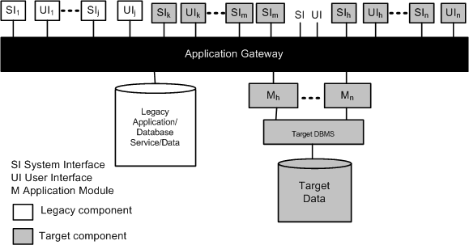
5.5.5 Chicken Little
The application gateway has been illustrated in Figure 5.9, and it is located between user and system interfaces and the legacy application.
Figure 5.9 Application gateway ©IEEE, 1999
Notes:
Handouts

Slide 34
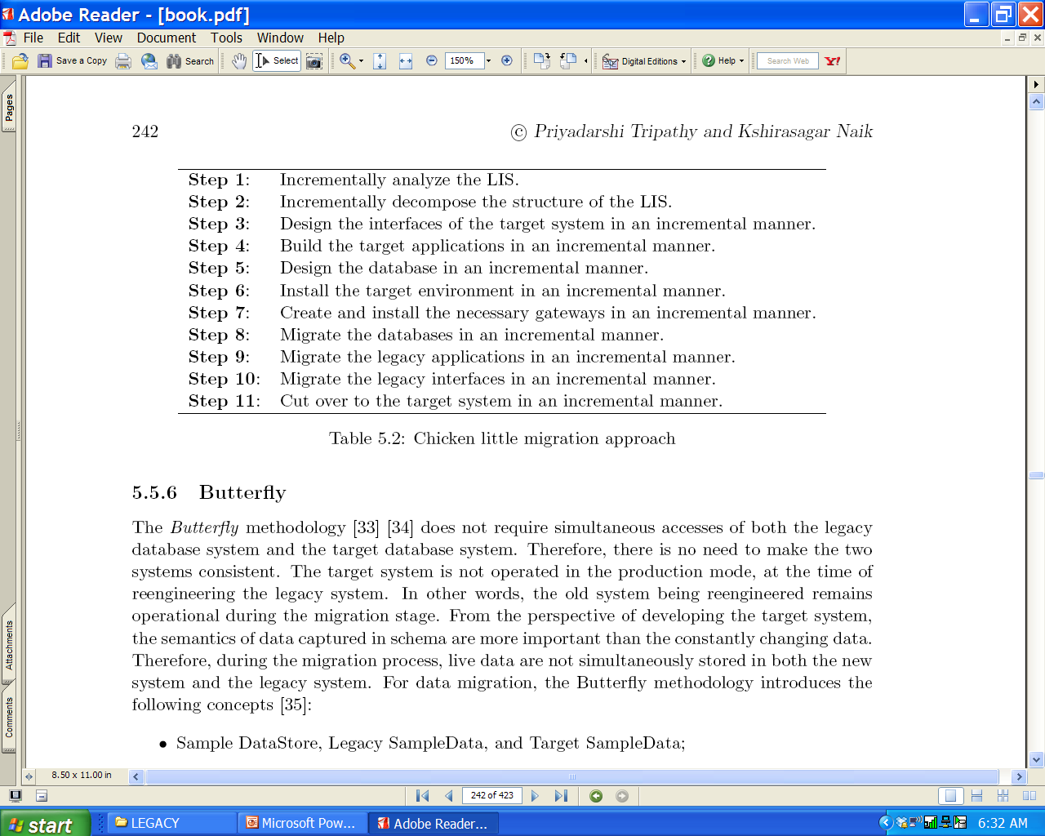
5.5.5 Chicken Little
The Chicken little methodology proposes an 11-step generic strategy, as listed on Table 5.2, for migration projects.
Notes:
Handouts

Slide 35
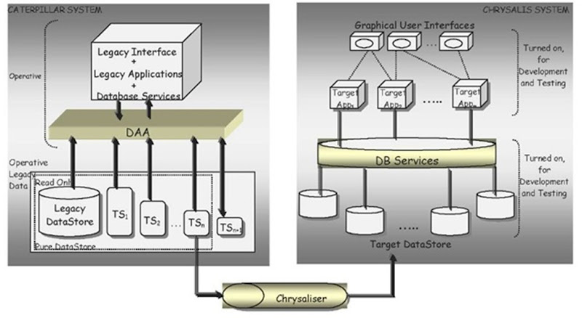
5.5.6 Butterfly
The Butterfly methodology does not require simultaneous accesses of both the legacy database system and the target database system.
The target system is not operated in the production mode, at the time of reengineering the legacy system.
In other words, the old system being reengineered remains operational during the migration stage.
During the migration process, live data are not simultaneously stored in both the new system and the legacy system.
For data migration, the Butterfly methodology introduces the following concepts:
  Sample DataStore, Legacy SampleData, and Target SampleData;
  TempStore;
  Data-Access-Allocator;
  Data-Transformer;
  Termination-Condition and Threshold Value.
Drawback of Butterfly Methodology
The main drawback of the Butterfly methodology is that the legacy database is used for reading only, whereas modifications are placed in a separate, temporary database.
Consequently, when there is a need to access some data, the system reads both the databases – the old database and the target database – plus the temporary database.
As a result, there is an increase in the time to access the required data.
Notes:
Handouts

Slide 36
5.5.7 Iterative
The iterative method implies that one component at a time is reengineered.
Thus, the legacy system gradually evolves over a period of time.
The methodology enables simultaneous operations of the reengineered system and the components of the legacy system.
An iterative methodology partitions legacy data into two categories:
  Primary data: Primary data are those data that are essential to an application’s business functions.
  Residual data: These data are not required to carry out the application’s business functions, but are used by the legacy system.
Notes:
Handouts

Slide 37
5.5.7 Iterative
Each Component may be in one of the following states during the reengineering process:
  Legacy: This state means that the component has not been reengineered, which implies that it continues to be a legacy component.
  Restored: The structure of the component remains the same and it performs the same functions, but the component accesses data through the new Data Banker.
  Reengineered: The component has already been modified, and a desired level of quality has been achieved.
  New: The component was not part of the legacy system and has been newly added in order to introduce new functions.
Notes:
Handouts

Slide 38
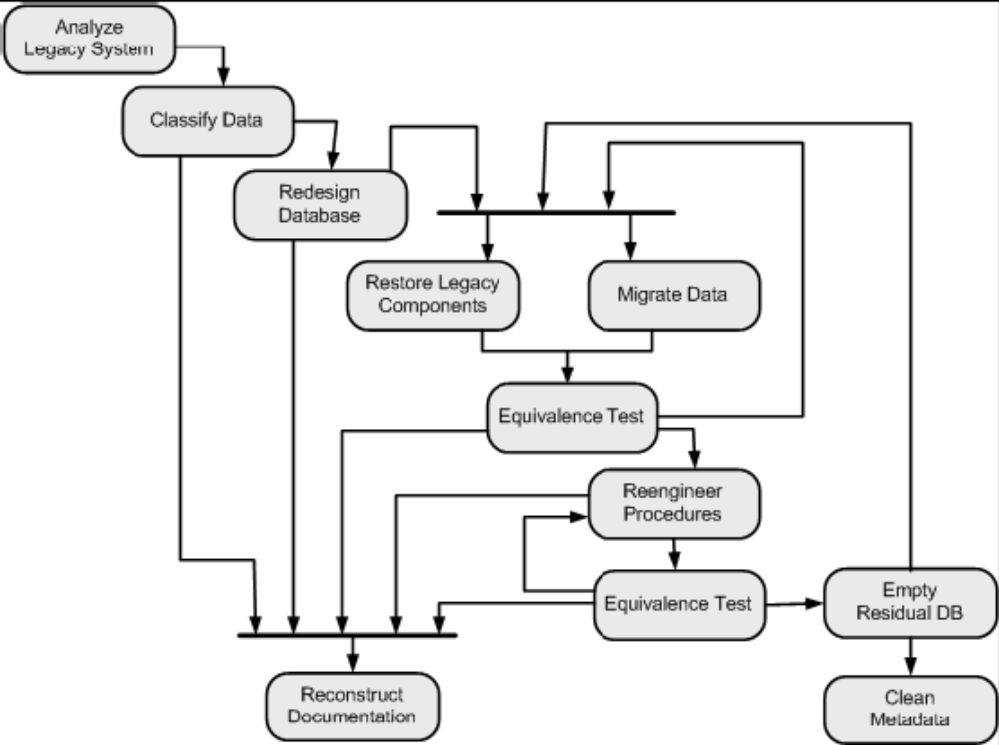
5.5.7 Iterative
Migration Process
Figure 5.13 The iterative migration process ©IEEE, 2003
Notes:
Handouts

Slide 39
5.5.7 Iterative
Migration Process
1- Analyze Legacy System:
All the change requests having an influence on a component to be reengineered are put aside until the component is reengineered. Therefore, the system is partitioned into components so as to minimize their client-supplier relationships for two reasons:
  (i) to minimize the number of change requests (CRs) to be frozen.
  (ii) to minimize the time durations for which CRs are frozen.
2- Classify Data:
Legacy data are classified as primary or residual data.
All the data in the Legacy DB, which are non-duplicated, are recorded in a table produced by means of data classification.
3- Redesign Database:
The data classified before are restructured in this phase:
  (i) to reorganize them in the new database for more effective and efficient access.
  (ii) to eliminate all the defects in the legacy database.
  (iii) to eliminate redundant data.
While describing the mode of access for the new database, define the characteristics of the data to be stored in the database for Metadata.
Notes:
Handouts

Slide 40
5.5.7 Iterative
Migration Process
4- Restore Legacy Components:
The legacy system program is made compatible with the new database.
To make the program compatible, the codes involved in accessing the data are identified.
The identified code are replaced with new ones that call the Data Banker, rather than access data directly.
5- Migrate Data:
The legacy database is incrementally migrated to the new database, and non-essential data are put in the residual database.
6- Reengineer Procedures:
Functions are reengineered in this phase, thereby evolving them from the restored state to the reengineered state.
Notes:
Handouts

Slide 41
5.5.7 Iterative
Migration Process
7- Equivalence Tests:
Equivalence testing ensures that, after migration, the system continues to execute the same way as it did before.
8- Empty Residual DB:
In iterative reengineering, some parts of the legacy database are migrated into the New DB, whereas the remaining parts move into the Residual DB.
While performing reengineering in an iterative manner, data to be no longer used are removed from the Residual DB.
Therefore, by the end of the reengineering process, the Residual DB will be completely empty.
Consequently, the Residual Data Manager and the Data Locator components can be withdrawn from the system.
Notes:
Handouts

Slide 42
5.5.7 Iterative
Migration Process
9- Iteration:
The components of the legacy system are reengineered one at a time.
After reengineering a selected component, the process is repeated for another component and so on, until the entire system has been reengineered.
10- Clean Metadata:
Upon completion of reengineering, Metadata only reflects the contents of the New DB.
Therefore, metadata concerning Residual DB are no more needed; hence, those are eliminated from Metadata.
In addition, all procedures in the Data Banker, which communicate with the Data Locator are removed.
11- Reconstruct Documentation:
Documentation reengineering proceeds concurrently with the actual migration.
Up-to-date documentation can be performed throughout the reengineering process.
Notes:
Handouts

Slide 43
Summary
  General Idea
  Wrapping
  Migration
  Migration Planning
  Migration Methods
Notes:
Handouts

